Slide 1
Parsing Service
OPF training cycle
Leszek Deska
28.01.2019
© 2019 Fidelity National Information Services, Inc. and/or its affiliates (“FIS”). All Rights Reserved. FIS confidential.

Slide 2
Agenda
Introduction
Location within OPF
Internal architecture
Types of parsers
XMLMapperBasedParser
XSDBasedParser
StaXParser
FlatFileParser
EDIFileParser
EmptyFileParser

Slide 3
Parsing Service is responsible for mapping input file content into
OPF database entities

Slide 4
Introduction
Parsing service is able to extract data from
JMS message
Memory
File
Database table (most common case)
Data parsed once, in one request, progressively
One-pass streaming parser
Data is converted on the fly from input stream to database entities
Only most recent data is kept until it’s converted and persisted and then discarded
Output of parsing service is
Persisted in database payment objects (instructions and transactions)
Starting of OPF business flow to trigger further processing of payments

Slide 5
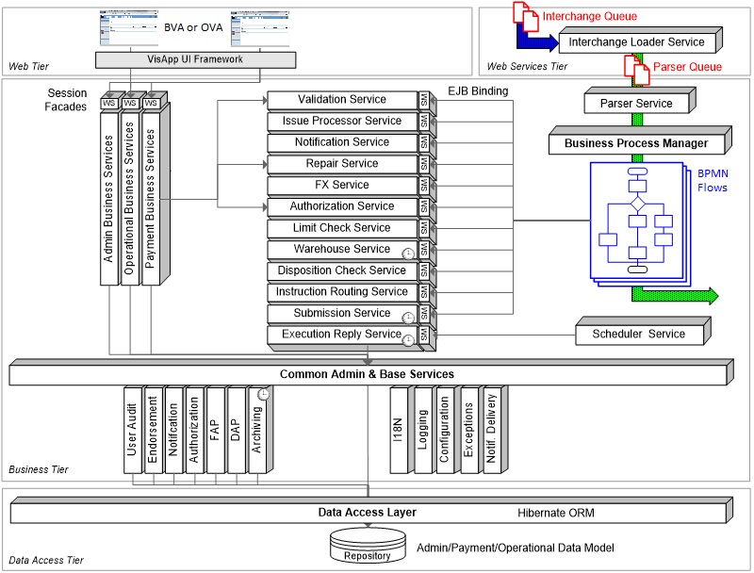

Slide 6
Introduction
Parsing service is run after Interchange Loader and before first Payment Flow is launched
Interchange Loader loads raw data from input file into database
Parser loads that raw data from database, analyzes it and creates payment entities in database
Payment Flow launches OPF services which operate on payment entities stored in database
Each fore mentioned component acts in own distributed transaction
Distributed transaction (XA) scope is set using message queues
Interchange Loader is triggered by Message Driven Bean listening on OPF input queue (InterchangeLoaderQ)
Interchange Loader (as it’s last action) puts a message on parser queue (ParserQ) to parse file that was just loaded
Parser is triggered by Message Driven Bean listening on parser queue
Parser (as it’s last action) puts a message on flow initiation queue (FlowInitiationQ) to start first flow for just parsed interchange
First Payment Flow (interchange flow) is triggered by Message Driven Bean listening on flow initiation queue

Slide 7
Parsing Service
is based on
Business Service Pattern
Described already in separate training

Slide 8
Parsing Service Flow of control
Message with interchange key to parse arrives at message queue
MDB calls EJB
EJB calls POJO
POJO executes Parsing
MDB
EJB
POJO
<xml>
<aa>
XYZ
</aa>
</xml>
Message Driven Bean
(onMessage() method) is triggered by application server
(MDB usually listens at jms/ParserQ)
SLSB
Stateless Session Bean
with remote and local interface
Plain Old Java Object
Contains whole logic (MDB and EJB are just delegating execution of parsing to POJO)

Slide 9
Types of parsers
Empty file parser EmptyFileParser
Flat file parser FlatFileParser
EDI file parser EDIFileParser
XSD file parser XSDBasedParser
BES parser XMLMapperBasedParser
STAX parser StaXParser

Slide 10
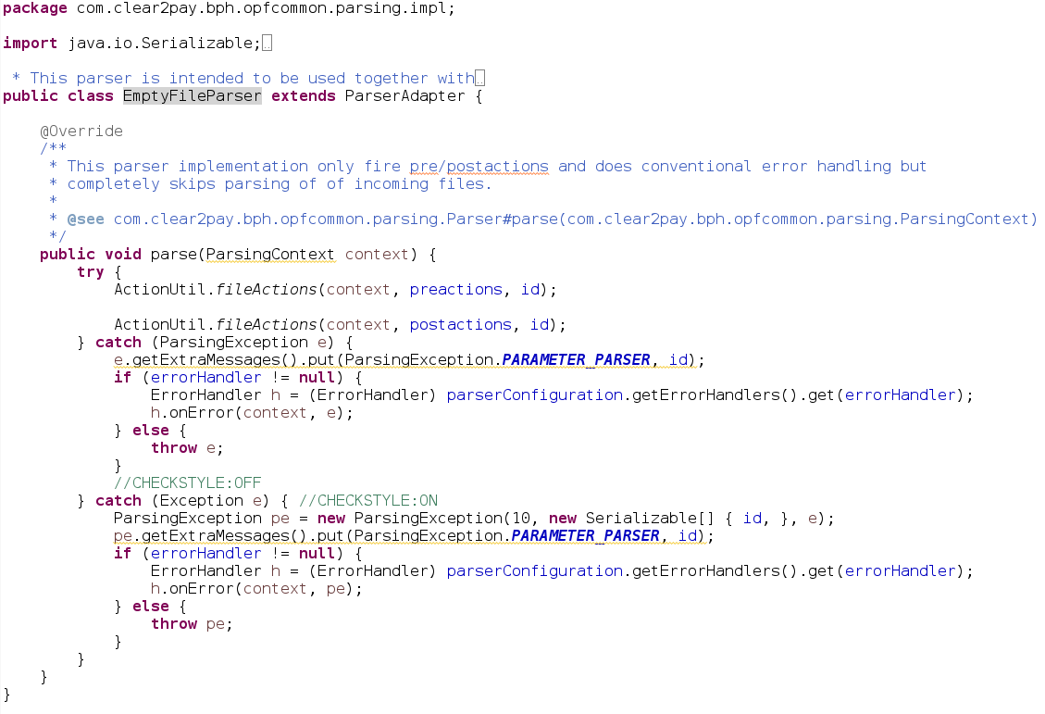
Empty File Parser
Does not do any processing, only executes pre-actions and post-actions
To be used when file with empty body needs to be processed
Supports auto-detection
Supports error handlers defined at parser level

Slide 11
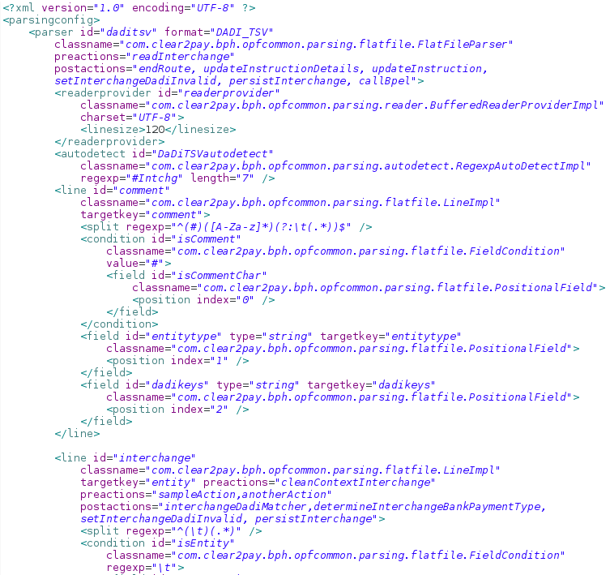
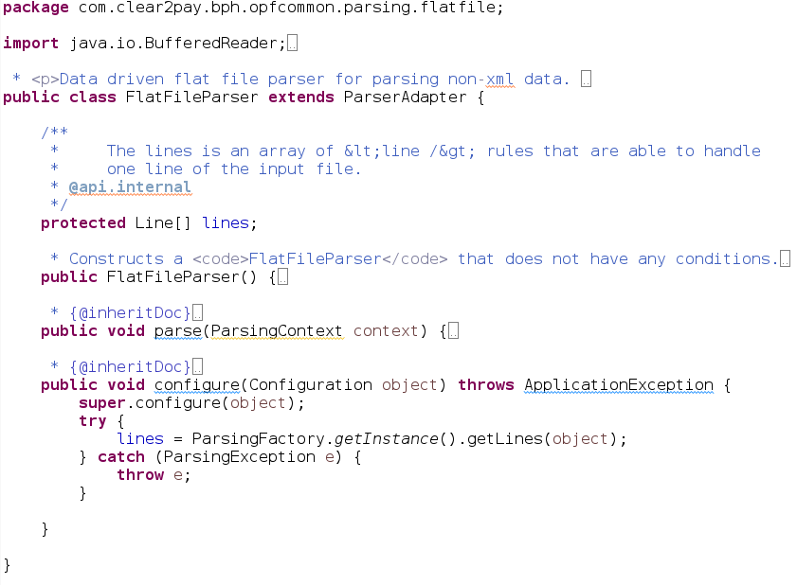
Flat File Parser
can parse variable and fixed width text files
Use this parser for csv, MT, AUS DE input files
Prior to parsing all preactions at parser level are executed
If parsing completes successfully then all postactions are executed
Flat file is comprised of one or more Lines
Line can have an associated Condition
Line has one or more Fields
Lines may be fixed-width, delimited or a combination of both
MT – Message Text, used in XCT product (SWIFT payments)
AUS DE – Australian Direct Entry

Slide 12
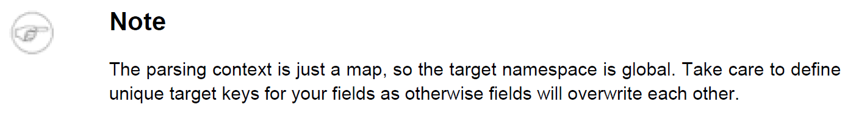
Flat File Parser
Parser iterates over all lines of input file and for each line:
Selects Line by running isApplicable() method
Once Line is selected:
Executes all preactions configured for this line
Iterates through all Fields configured and runs parsing of this field by running parse() method on that java object
Executes all postactions configured for this line
Usually Line parses a value and stores it’s value in ParsingContext
One of postactions usually copies all stored values from ParsingContext to payment entity
Another of postactions persists payment entity in database
Last of parser postactions launches BPMN flow which processes payments from this file
The targetkey attribute of each Field specifies the key under which the data will be bound into the parsing context.

Slide 13
EDI File Parser
Process EDI (Electronic Data Interchange) formats
It’s a self-describing format where length and type of data is encoded in file (not known up front)
A typical EDI file is comprised of one or more records, defined as EDILines.
Each line contains one or more EDIFields. Lines have an associated record type.
EDIFileParser provides similar functionality to the FlatFileParser. However, unlike the FlatFileParser where the parser controls the reading of lines in conjunction with a BufferedReader, in the EDI case, the extraction of records from the input stream is controlled by the records themselves.
See OPF Developer Guide for detailed description

Slide 14
BES parsers

Slide 15
BES parsers are configured by Business Analysts using Visual ToolKit
See separate training on Visual ToolKit for details

Slide 16

BES parsers
All BES parsers use BREF (Business Rules Expression Framework) to express parsing rules
BES parsers
Example of Business rule
BES text parsers
(based on FlatFileParser described earlier)
BES XML parsers
(explained later)
XSD schema based
XSDBasedInterchangeParser
ISO catalogue based
XMLMapperBasedParser

Slide 17
BES parsers
BES XML parsers
BES text parsers
BES parsers are meant to limit or eliminate the need for manually written java code and xml configuration to implement parsing. Business Analysts define parsing rules using VTK (Visual ToolKit) and use BES (Business Expression Syntax) to define business rules.
Developers generate parser configuration from VTK and incorporate it into the code base.

Slide 18
BES XML parsers
Support is provided for both generic XSD schema-based message mapping and ISO message mapping.
For the XSD schema-based the necessary XSD schemas (that will be stored in .xsd file) must be provided.
For ISO message mapping an ISO Catalog is used (will be stored in .prx file).
From once the user has specified the reference sources (XSD schema files or ISO Catalog), the mapping process (in Visual ToolKit) is identical.

Slide 19
BES XML parsers
Slide presents the way BES XML parser is defined using Visual ToolKit (VTK).
Refer to VTK trainings for details on how to define parser (task done usually by Business Analyst).
Visual ToolKit generates OPF configuration that should not be altered. It is described in following slides.

Slide 20
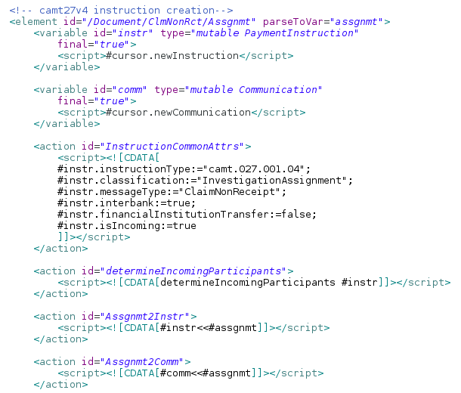
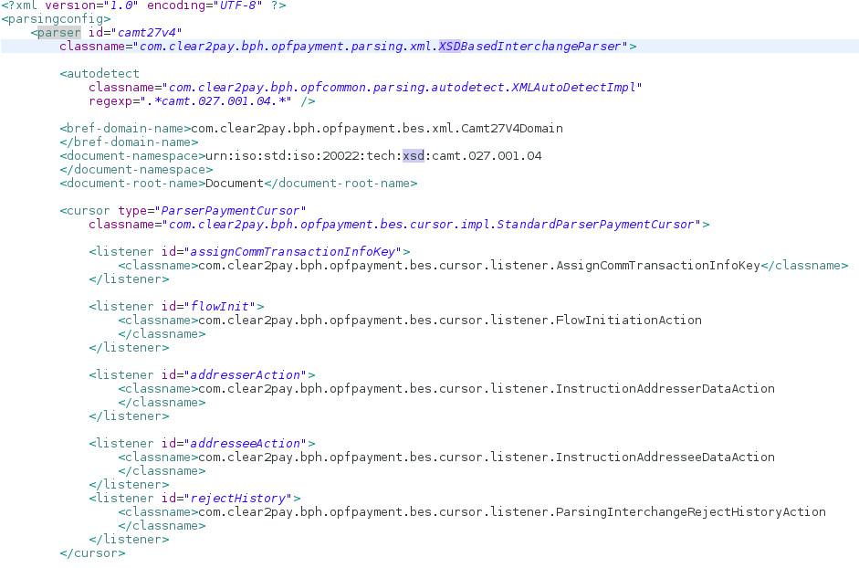
XSD File Parser
Streamed parsing
In memory parsing
XSDBasedParser processes XML data using XSD description of the XML format
Uses combination of SAX and DOM approaches
Relies on
Autodetect
ParserPaymentCursor
BREF scripts
To detect if this parser is applicable to current file. Identically like other parsers.
To loop over all the payment data in the XML payment file, and process it in
chunks
To perform the mapping of the payment data to OPF entities and DaDi
attributes

Slide 21
XSD File Parser
Business related logic is done by listeners of ParserPaymentCursor e.g.:
Participant determination
Pre-routing
Creation of payment entities
Starting of BPMN flow at the end of parsing
All mapping logic is done by BREF actions
XSDBasedParser do not use ParsingContext, data is kept in variables
Variables have scope of XML element in which they are defined

Slide 22
XML Mapper parser
The XMLMapperBasedParser parses incoming ISO20022 formatted payment files according to Mapping Files.
The Mapping File for a given ISO20022 message format not only knows the structure of the ISO format but also defines its mapping onto the corresponding OPF Payment entities.
The XMLMapper engine knows how to play the mapping transforms defined in the Mapping File, and therefore executes them.
Mapping File is designed and generated by a BA using the VSDK
No manual translation of the BAs work by developers is needed
XMLMapper engine is an "interpreter" of the Mapping File

Slide 23
XML Mapper parser
While processing a Mapping Transform, the XMLMapper engine issues events.
Entity creation events (to create PaymentInstruction or PaymentTransaction)
Other events, usually to populate payment entity attribute, convert value read, validate input
Handling of events is done by listeners
Validation of input vs ISO20022 catalogue is done at three levels:
Validation check (correct type, length)
Multiplicity check (is element mandatory, is it present not less and not more times as allowed)
Constraints check (validating complex expression defined in ISO20022 catalogue)
Each validation might be enabled or disabled by configuration

Slide 24
XML Mapper parser components
Loads the Mapping File that will drive the transformation of the
message to parse
Reads the input XML and feeds the XMLMapper engine with tags and their values
Autodetect is identical to other parsers
Provides listeners for entity creation events
Provides listeners for other events, for example populating payment entities
Process exceptions thrown by the XMLMapper engine during validation of entries

Slide 25
XML Mapper parser
Further reading:
OPF Developer Guide
chapter Parsing Service
Javadoc of parsing service classes
listed in previous slides
Java code for details
package com.clear2pay.bph.opfcommon.parsing
package com.clear2pay.bph.opfpayment.parsing

Slide 26
StAX parser

Slide 27
StAX parser processes XML data
Use it when no XSD schema is available

Slide 28
StAX parser
XML parsers
Reads XML file progressively
Data is pulled from XML stream
DOM
Stream parsers
Loads whole XML file into memory
Events are pushed to application
SAX
StAX

Slide 29
StAX parser components
Actions might be defined at parser level or element level
Standard autodetect capability
Main class implementing OPF StAX parser

Slide 30
StAX parser

Slide 31
StAX parser

Slide 32
Parsing Service

